Slide 1
Vertical Handover
-By….
Jaldeep Vasavada
Pranav Shah

Slide 2
Presentation Outline
Introduction
System Characteristics and Requirements
Handover
Vertical Handoff
How Mobile IP works?
Vertical Handoff using TCP/IP
Disadvantages of using MobileIP scheme for Vertical Handover
Solution to V-Handoff : P- Handoff
Conclusion

Slide 3
Introduction
Ubiquitous , Mobile Systems and the Internet
Vertical Handover
Objective

Slide 4
System Characteristics and Requirements
Identification
Care of Addressing
IMHP – Internet Mobile Host Protocol
Seamless Connectivity

Slide 5
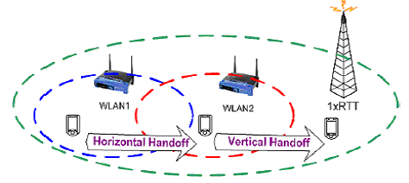
Handover
Handover - Definition
Types of Handover
    Hard Handover – GSM
    Soft Handover – CDMA
Horizontal Handover
Vertical Handover

Slide 6
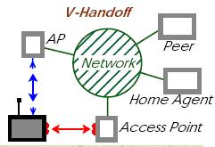
Vertical Handoff
Basic Premise : Seamless Connectivity
Based on Mobile IP
Developed For IPv6….

Slide 7
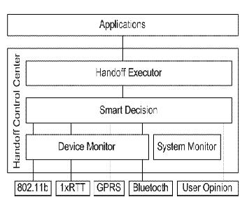
How Mobile IP works?
(Vertical Handover)
Host Node
Home Agent
Foreign Agent
Mobile Node
Tunnelling and Vertical Handover
Smart Decision Model

Slide 8
Vertical Handoff using TCP/IP
Problem : - Continuously Mobile Node
      - Triangular Routing
Solution : TCP/IP implementation of V-Handover
Changing IP Address Continuously….
TCP Migration
Problems: - Slow TCP Start
      - Slow due to Mobile IP Advertisements
      - War Diving ….

Slide 9
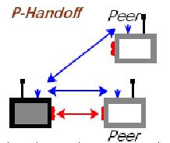
Solution to V-Handoff :
P- Handoff
Implemented upon Linux Server
Complementary to Mobile IP
Uses Global IP Address
Selection for the Best Link
Response and Native Discovery Protocols
Host Router → Global IP Address [ Connection Manager ]

Slide 10
Conclusion
Wireless Diversity - Problems…
Solution
References
Mobile Computing -By: Asoke K Talukder, Roopa R Yavagal.
Vertical Handover –By: V. Ghini, G. Pau, P. Salomoni, M. Roccetti
Vertical Handover –By: V. Ghini, G. Pau, P. Salomoni, M. Roccetti
www.wikipedia.com
www.ieee.com
www.comsdesign.com/design_corner

Slide 11

Thank You

